Slide 1
1.Parallel and Distributed Databases
<number>
N.R.Sonawane
<number>

Slide 2
Parallel database
- Introduction
- Architecture for Parallel databases.
- Parallel query Evaluation.
- Key elements of Parallel Database Processing
<number>
<number>

Slide 3

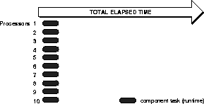
Parallel Processing Parallel processing divides a large task into many smaller tasks, and executes the smaller tasks concurrently on several nodes. As a result, the larger task completes more quickly. For example, in a bank with only one counter, all customers must form a single queue to be served. With two counters, the task can be effectively split so that customers form two queues.
This is an instance in which parallel processing is an effective solution.

Slide 4
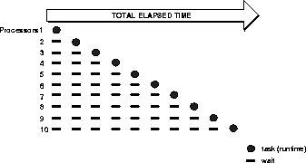
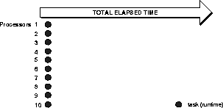
Sequential processing of multiple independent tasks from an online transaction processing
Parallel Processing of multiple independent tasks from an online transaction processing
<number>
Parallel Processing: Executing Independent Tasks in Parallel

Slide 5
Problems of Parallel Processing
Effective implementation of parallel processing involves two challenges:
structuring tasks so that certain tasks can execute at the same time (in parallel)
preserving the sequencing of tasks which must be executed serially
Characteristics of a Parallel System
A parallel processing system has the following characteristics:
Each processor in a system can perform tasks concurrently.
Tasks may need to be synchronized.
Nodes usually share resources, such as data, disks, and other devices.
<number>
N.R.Sonawane

Slide 6
Parallel Database
What Is a Parallel Database?
A variety of hardware architectures allow multiple computers to share access to data, software, or peripheral devices.
A parallel database is designed to take advantage of such architectures by running multiple instances which "share" a single physical database.
A parallel database to improve performance through parallelization of various operations, such as loading data, building indexes and evaluating queries..
<number>
N.R.Sonawane

Slide 7
PARALLEL DBMS
HOW TO MEASURE THE PERFORMANCE
Speed-Up
Adding more resources results in proportionally less running time for a fixed amount of data.
10 seconds to scan a DB of 10,000 records using 1 CPU
1 second to scan a DB of 10,000 records using 10 CPUs
Scale-Up
- If resources are increased in proportion to an increase in data/problem size, the overall time should remain constant
1 second to scan a DB of 1,000 records using 1 CPU
1 second to scan a DB of 10,000 records using 10 CPUs
<number>
N.R.Sonawane
<number>

Slide 8
PARALLEL DBMS
HOW TO MEASURE THE PERFORMANCE
Speed-Up
Speedup is the effect of applying an increasing number of resources to a fixed amount of work to achieve a proportional reduction in execution times
Speedup increases the Response Time, i.e, the time to complete a task is reduced.
10 seconds to scan a DB of 10,000 records using 1 CPU
1 second to scan a DB of 10,000 records using 10 CPUs
Scale-Up
Scaleup is the ability to keep the same performance levels (response time) when both workload (transactions) and resources (CPU, memory) increase proportionally.
Scaleup increases the Throughput, i.e, number of tasks completed in a given time increased.
1 second to scan a DB of 1,000 records using 1 CPU
1 second to scan a DB of 10,000 records using 10 CPUs
<number>
<number>
N.R.Sonawane

Slide 9
Objectives
The primary objective of parallel database processing is to gain performance improvement
Two main measures:
Throughput: the number of tasks that can be completed within a given time interval
Response time: the amount of time it takes to complete a single task from the time it is submitted
Metrics:
Speed up
Scale up
D. Taniar, C.H.C. Leung, W. Rahayu, S. Goel: High-Performance Parallel Database Processing and Grid Databases, John Wiley & Sons, 2008
Notes:
<number>

Slide 10
Objectives
The primary objective of parallel database processing is to gain performance improvement
Two main measures:
Throughput: the number of tasks that can be completed within a given time interval
Response time: the amount of time it takes to complete a single task from the time it is submitted
Metrics:
Speed up
Scale up
D. Taniar, C.H.C. Leung, W. Rahayu, S. Goel: High-Performance Parallel Database Processing and Grid Databases, John Wiley & Sons, 2008
Notes:
<number>

Slide 11
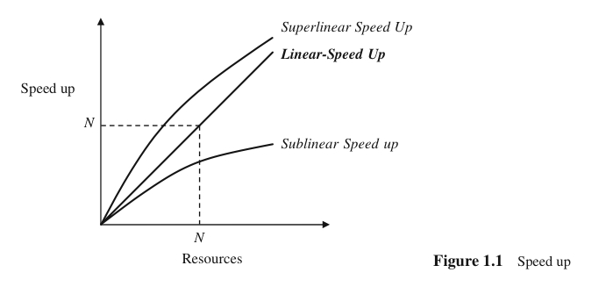

Objectives (cont’d)
Speed up
Performance improvement gained because of extra processing elements added
Running a given task in less time by increasing the degree of parallelism
Linear Speedup
Speedup is linear if the speedup is N. That is, the small system elapsed time is N times larger than the large system elapsed time (N is number of resources, say CPU).
For example, if single machine does the job in 10 seconds and if parallel machine (10 single machine) does the same job in 1 second, then the speedup is (10/1)=10 which is speedup and it is linear because the speedup is achieved due to the 10 times powerful system.
Sub-Linear Speedup
Speedup is sub-linear if speedup is less than N (which is usual in most of the parallel systems).
D. Taniar, C.H.C. Leung, W. Rahayu, S. Goel: High-Performance Parallel Database Processing and Grid Databases, John Wiley & Sons, 2008
Notes:
<number>

Slide 12
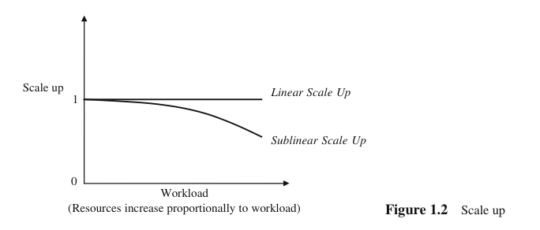

Objectives (cont’d)
Scale up
Handling of larger tasks by increasing the degree of parallelism
The ability to process larger tasks in the same amount of time by providing more resources.
Linear Scale up
Scaleup is linear if the resources increase in proportional with the problem size.
According to the equation given above, if small system small problem elapsed time is equal to large system large problem elapsed time, then Scaleup = 1 which is linear.
Sub-linear Scale up
Scaleup is sub-linear if large system large problem elapsed time is greater than small system small problem elapsed time, then the scaleup is sub-linear.
D. Taniar, C.H.C. Leung, W. Rahayu, S. Goel: High-Performance Parallel Database Processing and Grid Databases, John Wiley & Sons, 2008
Notes:
<number>

Slide 13
Architectures for Parallel Databases
The basic idea behind Parallel DB is to carry out evaluation steps in parallel whenever is possible.
There are many opportunities for parallelism in RDBMS.
3 main architectures have been proposed for building parallel DBMSs.
Shared Memory
Shared Disk
Shared Nothing
<number>
N.R.Sonawane
<number>

Slide 14
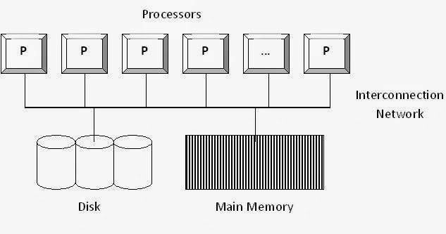
Shared Memory
Figure 1 - Shared Memory Architecture
Advantages:
Simple implementation
Establishes effective communication between processors through single memory addresses space
Above point leads to less communication overhead.
Disadvantage:
It leads to bottleneck problem
Expensive to build
It is less sensitive to partitioning
<number>
N.R.Sonawane
<number>

Slide 15
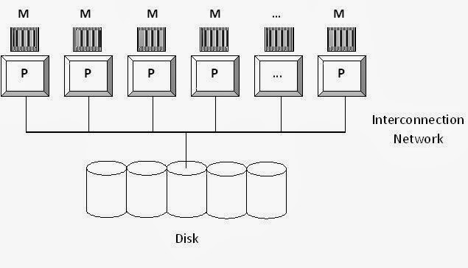
Shared Disk
Advantages:
Failure of any processors would not stop the entire system (Fault tolerance)
Interconnection to the memory is not a bottleneck. (It was bottleneck in Shared Memory architecture)
Support larger number of processors (when compared to Shared Memory architecture)
Disadvantages:
Interconnection to the disk is bottleneck as all processors share common disk setup.
Shared disk less sensitive to partitioning
Figure 2 - Shared Disk Architecture
<number>
N.R.Sonawane
<number>

Slide 16
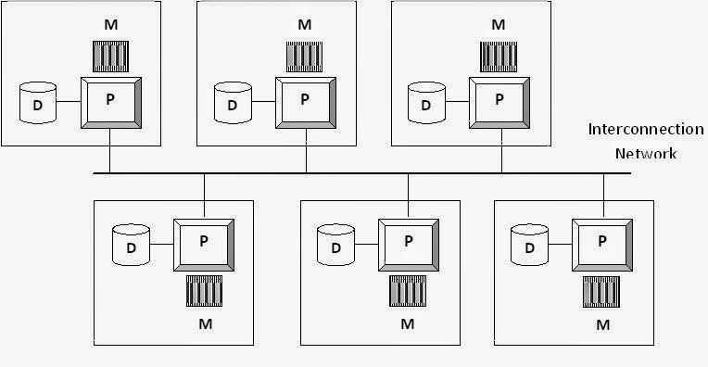
Shared Nothing
Figure 3 - Shared Nothing Architecture
Advantages:
It provides linear scale up & linear speed up
Shared nothing benefits from "good" partitioning
Cheap to build
Disadvantage
Hard to program
Addition of new nodes requires reorganizing
<number>
N.R.Sonawane
<number>

Slide 17
PARALLEL QUERY EVALUATION
A relational query execution plan is graph/tree of relational algebra operators
<number>
N.R.Sonawane
<number>

Slide 18
Different Types of DBMS ||-ism
Parallel evaluation of a relational query in DBMS With shared –nothing architecture
Inter-query parallelism
Multiple queries run on different sites
Intra-query parallelism
Parallel execution of single query run on different sites.
Intra-operator parallelism
get all machines working together to compute a given operation (scan, sort, join).
Inter-operator parallelism
each operator may run concurrently on a different site (exploits pipelining).
In order to evaluate different operators in parallel, we need to evaluate each operator in query plan in Parallel.
<number>
N.R.Sonawane
<number>

Slide 19
Objectives (cont’d)
Parallel Obstacles
Start-up and Consolidation costs,
Interference and Communication, and
Skew
D. Taniar, C.H.C. Leung, W. Rahayu, S. Goel: High-Performance Parallel Database Processing and Grid Databases, John Wiley & Sons, 2008
Notes:
<number>

Slide 20
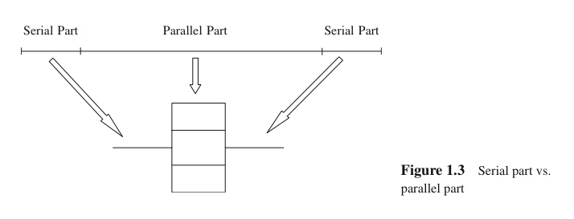
Objectives (cont’d)
Start-up and Consolidation
Start up: initiation of multiple processes
Consolidation: the cost for collecting results obtained from each processor by a host processor
D. Taniar, C.H.C. Leung, W. Rahayu, S. Goel: High-Performance Parallel Database Processing and Grid Databases, John Wiley & Sons, 2008
Notes:
<number>

Slide 21
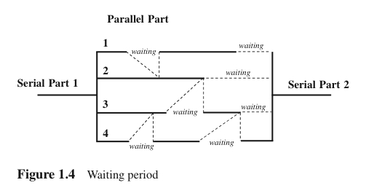
Objectives (cont’d)
Interference and Communication
Interference: competing to access shared resources
Communication: one process communicating with other processes, and often one has to wait for others to be ready for communication (i.e. waiting time).
D. Taniar, C.H.C. Leung, W. Rahayu, S. Goel: High-Performance Parallel Database Processing and Grid Databases, John Wiley & Sons, 2008
Notes:
<number>

Slide 22
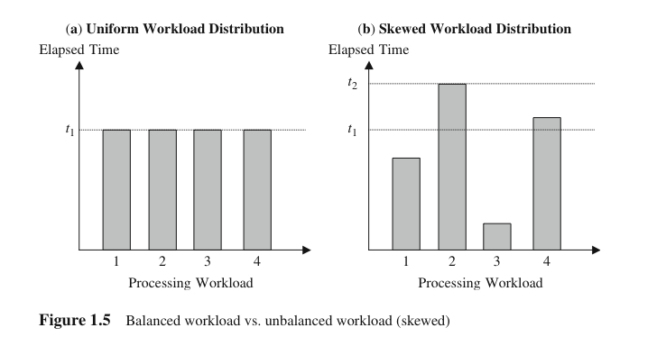
Objectives (cont’d)
Skew
Unevenness of workload
Load balancing is one of the critical factors to achieve linear speed up
D. Taniar, C.H.C. Leung, W. Rahayu, S. Goel: High-Performance Parallel Database Processing and Grid Databases, John Wiley & Sons, 2008
Notes:
<number>

Slide 23
Forms of Parallelism
Forms of parallelism for database processing:
Interquery parallelism
Intraquery parallelism
Interoperation parallelism
Intraoperation parallelism
Mixed parallelism
D. Taniar, C.H.C. Leung, W. Rahayu, S. Goel: High-Performance Parallel Database Processing and Grid Databases, John Wiley & Sons, 2008
Notes:
<number>

Slide 24
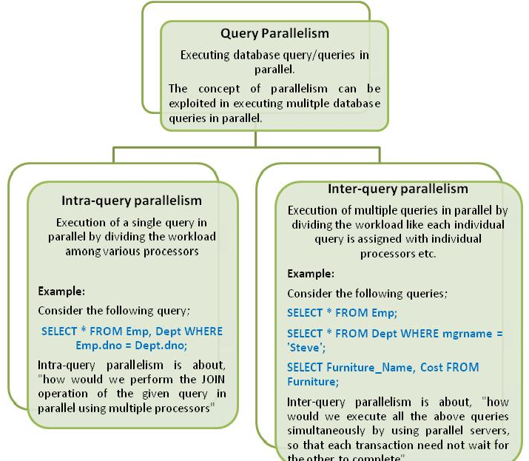
<number>
N.R.Sonawane

Slide 25
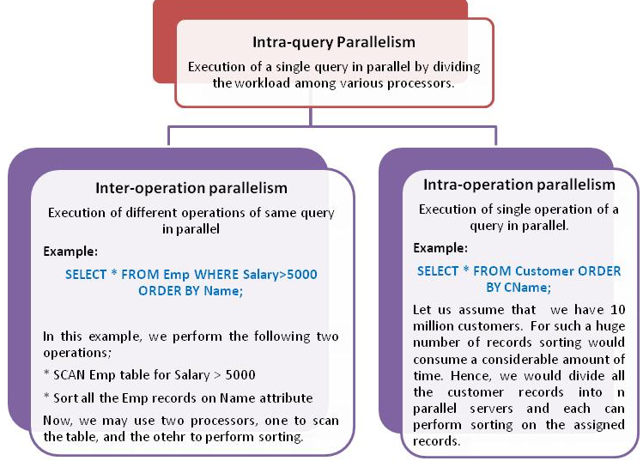
<number>
N.R.Sonawane

Slide 26
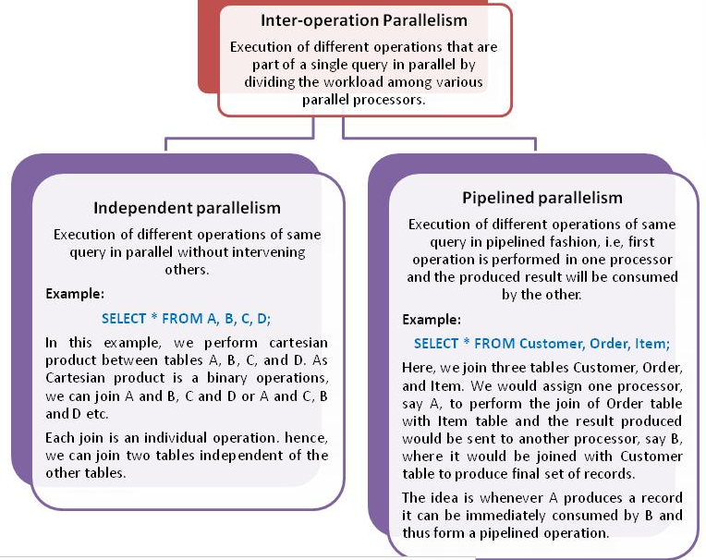
<number>
N.R.Sonawane

Slide 27
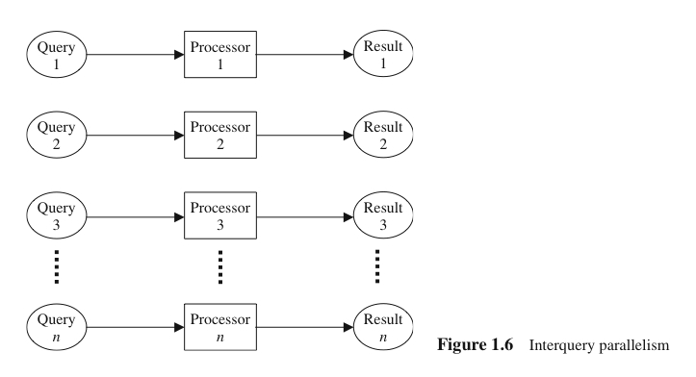
Forms of Parallelism (cont’d)
Interquery Parallelism
“Parallelism among queries”
Different queries or transactions are executed in parallel with one another
Main aim: scaling up transaction processing systems
D. Taniar, C.H.C. Leung, W. Rahayu, S. Goel: High-Performance Parallel Database Processing and Grid Databases, John Wiley & Sons, 2008
Notes:
<number>

Slide 28
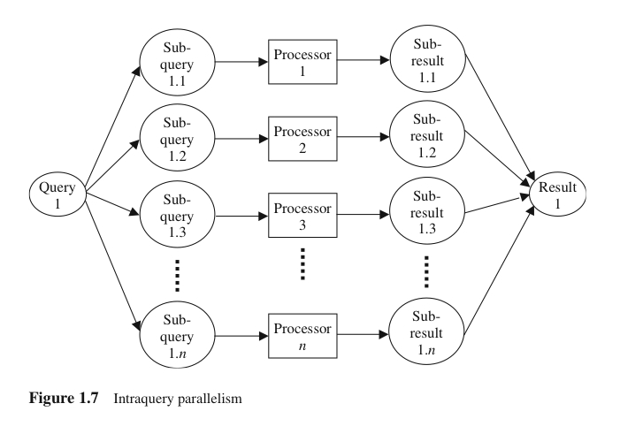
Forms of Parallelism (cont’d)
Intraquery Parallelism
“Parallelism within a query”
Execution of a single query in parallel on multiple processors and disks
Main aim: speeding up long-running queries
D. Taniar, C.H.C. Leung, W. Rahayu, S. Goel: High-Performance Parallel Database Processing and Grid Databases, John Wiley & Sons, 2008
Notes:
<number>

Slide 29
Forms of Parallelism (cont’d)
Execution of a single query can be parallelized in two ways:
Intraoperation parallelism: Speeding up the processing of a query by parallelizing the execution of each individual operation (e.g. parallel sort, parallel search, etc)
Interoperation parallelism: Speeding up the processing of a query by executing in parallel different operations in a query expression (e.g. simultaneous sorting or searching)
D. Taniar, C.H.C. Leung, W. Rahayu, S. Goel: High-Performance Parallel Database Processing and Grid Databases, John Wiley & Sons, 2008
Notes:
<number>

Slide 30
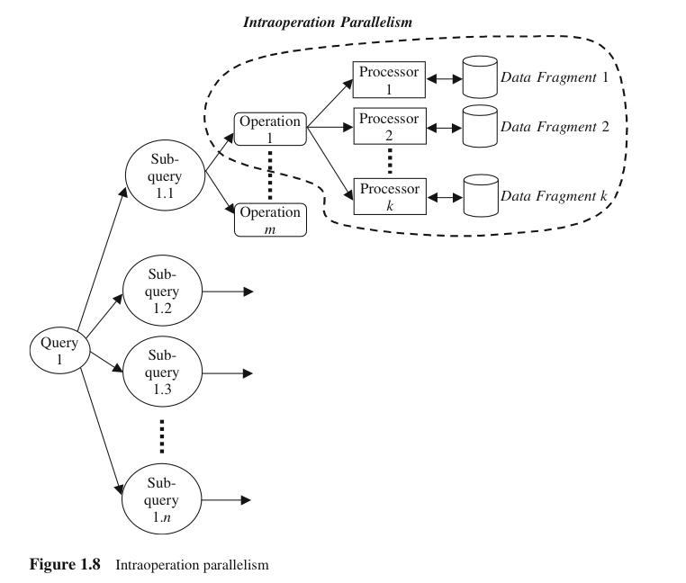
Forms of Parallelism (cont’d)
Intraoperation Parallelism
“Partitioned parallelism”
Parallelism due to the data being partitioned
Since the number of records in a table can be large, the degree of parallelism is potentially enourmous
D. Taniar, C.H.C. Leung, W. Rahayu, S. Goel: High-Performance Parallel Database Processing and Grid Databases, John Wiley & Sons, 2008
Notes:
<number>

Slide 31
Forms of Parallelism (cont’d)
Interoperation parallelism: Parallelism created by concurrently executing different operations within the same query or transaction
Pipeline parallelism
Independent parallelism
D. Taniar, C.H.C. Leung, W. Rahayu, S. Goel: High-Performance Parallel Database Processing and Grid Databases, John Wiley & Sons, 2008
Notes:
<number>

Slide 32
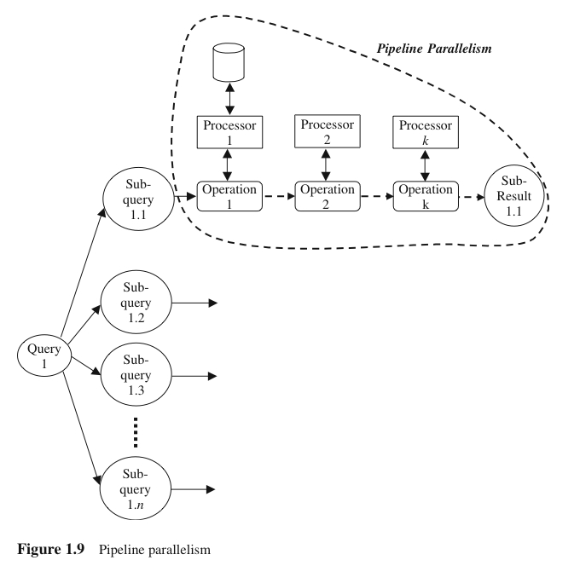
Forms of Parallelism (cont’d)
Pipeline Parallelism
Output record of one operation A are consumed by a second operation B, even before the first operation has produced the entire set of records in its output
Multiple operations form some sort of assembly line to manufacture the query results
Useful with a small number of processors, but does not scale up well
D. Taniar, C.H.C. Leung, W. Rahayu, S. Goel: High-Performance Parallel Database Processing and Grid Databases, John Wiley & Sons, 2008
Notes:
<number>

Slide 33
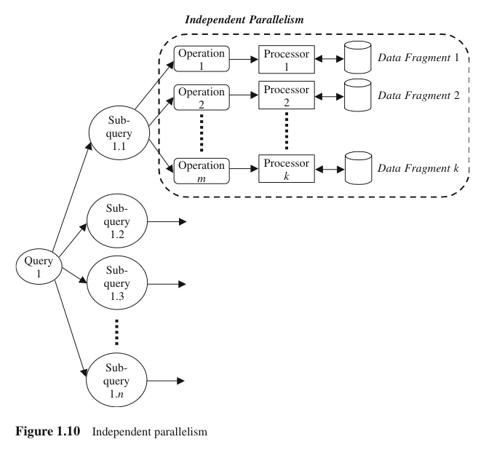
Forms of Parallelism (cont’d)
Independent Parallelism
Operations in a query that do not depend on one another are executed in parallel
Does not provide a high degree of parallelism
D. Taniar, C.H.C. Leung, W. Rahayu, S. Goel: High-Performance Parallel Database Processing and Grid Databases, John Wiley & Sons, 2008
Notes:
<number>

Slide 34
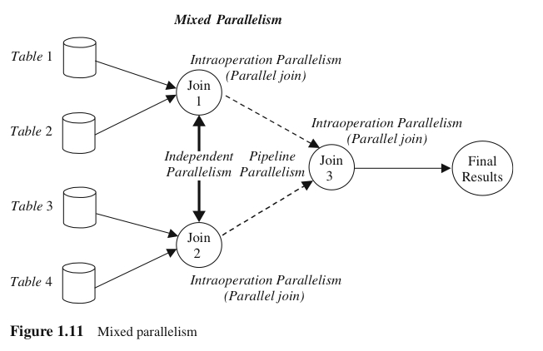
Forms of Parallelism (cont’d)
Mixed Parallelism
In practice, a mixture of all available parallelism forms is used.
D. Taniar, C.H.C. Leung, W. Rahayu, S. Goel: High-Performance Parallel Database Processing and Grid Databases, John Wiley & Sons, 2008
Notes:
<number>

Slide 35
1.7. Structure of the book
Part I: Introduction and analytical models
Parts II and III: Parallel query processing, including parallel algorithms and methods for all important database processing operations
Part IV: Grid transaction management, covering the ACID properties of transaction as well as replication in Grid
Part V: Parallelism of other data-intensive applications (OLAP and data mining)
D. Taniar, C.H.C. Leung, W. Rahayu, S. Goel: High-Performance Parallel Database Processing and Grid Databases, John Wiley & Sons, 2008
Notes:
<number>

Slide 36
Data Partitioning
Types of Partitioning
Horizontal Partitioning: tuple of a relation are divided among many disks such that each tuple resides on one disk.
It enables to exploit the I/O band width of disks by reading & writing them in parallel.
Reduce the time required to retrieve relations from disk by partitioning the relations on multiple disks.
Range Partitioning
Hash Partitioning
Round Robin Partitioning
Vertical Partitioning
<number>
N.R.Sonawane
<number>

Slide 37
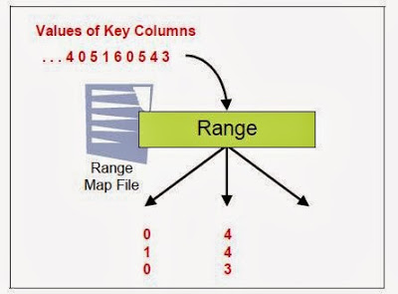
1.Range Partitioning
Tuples are sorted (conceptually), and n ranges are chosen for the sort key values so that each range contains roughly the same number of tuples;
tuples in range i are assigned to processor i.
Eg:
sailor _id 1-10 assigned to disk 1
sailor _id 10-20 assigned to disk 2
sailor _id 20-30 assigned to disk 3
range partitioning can lead to data skew; that is, partitions with widely varying number of tuples across
<number>
N.R.Sonawane
<number>

Slide 38
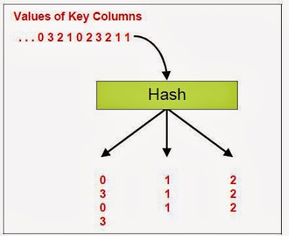
2.Hash Partitioning
A hash function is applied to selected fields of a tuple to determine its processor.
Hash partitioning has the additional virtue that it keeps data evenly distributed even if the data grows and shrinks over time.
<number>
N.R.Sonawane
<number>

Slide 39
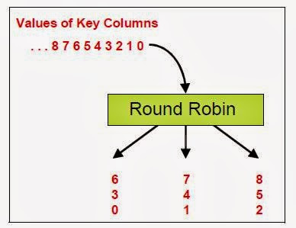
3.Round Robin Partitioning
If there are n processors, the i th tuple is assigned to processor i mod n in round-robin partitioning.
Round-robin partitioning is suitable for efficiently evaluating queries that access the entire relation.
If only a subset of the tuples (e.g., those that satisfy the selection condition age = 20) is required, hash partitioning and range partitioning are better than round-robin partitioning
<number>
N.R.Sonawane
<number>

Slide 40
Range Hash Round Robin
A...E
F...J
K...N
O...S
T...Z
A...E
F...J
K...N
O...S
T...Z
A...E
F...J
K...N
O...S
T...Z
Good for equijoins,
exact-match queries, and range queries
Good for equijoins, exact match queries
Good to spread load
<number>
N.R.Sonawane
<number>
Notes:
<number>

Slide 41
What Are the Benefits of Parallel Database?
1) Higher Performance
With more CPUs available to an application, higher speedup and scale up can be attained. The improvement in performance depends on the degree of inter-node locking and synchronization activities.
2) Higher Availability
Nodes are isolated from each other, so a failure at one node does not bring the whole system down. The remaining nodes can recover the failed node and continue to provide data access to users. This means that data is much more available than it would be with a single node upon node failure, and amounts to significantly higher availability of the database.
3) Greater Flexibility
An Parallel Server environment is extremely flexible. Instances can be allocated or deallocated as necessary. When there is high demand for the database, more instances can be temporarily allocated. The instances can be deallocated and used for other purposes once they are no longer necessary.
4) More Users
Parallel database technology can make it possible to overcome memory limits, enabling a single system to serve thousands of users.
<number>
N.R.Sonawane

Slide 42
Parallelizing Sequential Operator Evaluation Code
An elegant software architecture for parallel DBMSs enables us to readily parallelize existing code for sequentially evaluating a relational operator.
The basic idea is to use parallel data streams.
Streams are merged as needed to provide the inputs for a relational operator.
The output of an operator is split as needed to parallelize subsequent processing.
A parallel evaluation plan consists of a dataflow network of relational, merge, and split operators.
<number>
N.R.Sonawane
<number>

Slide 43
PARALLELIZING INDIVIDUAL OPERATIONS
How various operations can be implemented in parallel in a shared-nothing architecture?
Techniques
Bulk loading& scanning
Sorting
Joins
<number>
N.R.Sonawane
<number>

Slide 44
1.Bulk Loading and scanning
scanning a relation: Pages can be read in parallel while scanning a relation, and the retrieved tuples can then be merged, if the relation is partitioned across several disks.
bulk loading: if a relation has associated indexes, any sorting of data entries required for building the indexes during bulk loading can also be done in parallel.
<number>
N.R.Sonawane
<number>

Slide 45
2.Parallel Sorting :
Parallel sorting steps:
First redistribute all tuples in the relation using range partitioning.
Each processor then sorts the tuples assigned to it
The entire sorted relation can be retrieved by visiting the processors in an order corresponding to the ranges assigned to them.
Problem: Data skew
Solution: “sample” the data at the outset to determine good range partition points.
A particularly important application of parallel sorting is sorting the data entries in tree-structured indexes.
<number>
N.R.Sonawane
<number>

Slide 46
3.Parallel Join
The basic idea for joining A and B in parallel is to decompose the join into a collection of k smaller joins by using partition.
By using the same partitioning function for both A and B, we ensure that the union of the k smaller joins computes the join of A and B.
Hash-Join
Sort-merge-join
<number>
N.R.Sonawane
<number>

Slide 47
Sort-merge-join
partition A and B by dividing the range of the join attribute into k disjoint subranges and placing A and B tuples into partitions according to the subrange to which their values belong.
Each processor carry out a local join.
In this case the number of partitions k is chosen to be equal to the number of processors n .
The result of the join of A and B, the output of the join process may be split into several data streams.
The advantage that the output is available in sorted order
<number>
N.R.Sonawane
<number>

Slide 48
Dataflow Network of Operators for Parallel Join
Good use of split/merge makes it easier to build parallel versions of sequential join code
<number>
N.R.Sonawane
<number>

Slide 49
DDBMS
Introduction to DDBMS
Architecture of DDBs
Storing data in DDBs
Distributed catalog management
Distributed query processing
Transaction Processing
Distributed concurrency control and recovery
<number>
N.R.Sonawane
<number>

Slide 50
I.Introduction to DDBMS
Data in a distributed database system is stored across several sites.
Each site is typically managed by a DBMS that can run independently of the other sites that co-operate in a transparent manner.
Transparent implies that each user within the system may access all of the data within all of the databases as if they were a single database
There should be ‘location independence’ i.e.- as the user is unaware of where the data is located it is possible to move the data from one physical location to another without affecting the user.
<number>
N.R.Sonawane
<number>

Slide 51
DDBMS properties
Distributed data independence: Users should be able to ask queries without specifying where the referenced relations, or copies or fragments of the relations, are located.
Distributed transaction atomicity: Users should be able to write transactions that access and update data at several sites just as they would write transactions over purely local data.
<number>
N.R.Sonawane
<number>

Slide 52
DISTRIBUTED PROCESSING ARCHITECTURE
CLIENT
CLIENT
CLIENT
CLIENT
LAN
LAN
CLIENT
CLIENT
CLIENT
CLIENT
WIDE AREA NETWORK
Delhi
Mumbai
CLIENT
CLIENT
CLIENT
CLIENT
LAN
LAN
DBMS
CLIENT
CLIENT
CLIENT
CLIENT
<number>
N.R.Sonawane
Pune
Hyderabad
<number>

Slide 53
DISTRIBUTED DATABASE ARCHITECTURE
CLIENT
CLIENT
CLIENT
CLIENT
CLIENT
LAN
DBMS
DBMS
CLIENT
CLIENT
CLIENT
CLIENT
WIDE AREA NETWORK
Delhi
Mumbai
CLIENT
CLIENT
CLIENT
CLIENT
CLIENT
LAN
DBMS
DBMS
CLIENT
CLIENT
CLIENT
CLIENT
<number>
N.R.Sonawane
Pune
Hyderabad
<number>

Slide 54


Distributed database
Communication Network- DBMS and Data at each node
Users are unaware of the distribution of the data
DBMS
DBMS
Location transparency
DBMS
DBMS
<number>
N.R.Sonawane

Slide 55
Types of Distributed Databases
Homogeneous distributed database system :
If data is distributed but all servers run the same DBMS software.
Heterogeneous distributed database :
If different sites run under the control of different DBMSs, essentially autonomously, are connected to enable access to data from multiple sites.
The key to building heterogeneous systems is to have well-accepted standards for gateway protocols.
A gateway protocol is an API that exposes DBMS functionality to external applications.
<number>
N.R.Sonawane
1. Parallel DB /D.S.Jagli
<number>

Slide 56
DDBMS
Introduction to DDBMS
Architecture of DDBs
Storing data in DDBs
Distributed catalog management
Distributed query processing
Transaction Processing
Distributed concurrency control and recovery
<number>
N.R.Sonawane
1. Parallel DB /D.S.Jagli
<number>

Slide 57
2.DISTRIBUTED DBMS ARCHITECTURES
Client-Server Systems:
Collaborating Server Systems
Middleware Systems
<number>
N.R.Sonawane
<number>

Slide 58
1.Client-Server Systems:
A Client-Server system has one or more client processes and one or more server processes,
A client process can send a query to any one server process.
Clients are responsible for user-interface issues,
Servers manage data and execute transactions.
A client process could run on a personal computer and send queries to a server running on a mainframe.
The Client-Server architecture does not allow a single query to span multiple servers
<number>
N.R.Sonawane
<number>

Slide 59
TERMINALS
MAINFRAME COMPUTER
DUMB
DUMB
SPECIALISED NETWORK CONNECTION
DUMB
PRESENTATION LOGIC
BUSINESS LOGIC
DATA LOGIC
<number>
N.R.Sonawane
<number>

Slide 60
2.Collaborating Server Systems
The client process would have to be capable of breaking such a query into appropriate subqueries.
A Collaborating Server system can have a collection of database servers, each capable of running transactions against local data, which cooperatively execute transactions spanning multiple servers.
When a server receives a query that requires access to data at other servers, it generates appropriate subqueries to be executed by other servers .
puts the results together to compute answers to the original query.
<number>
N.R.Sonawane
<number>

Slide 61
M:N CLIENT/SERVER DBMS ARCHITECTURE
SERVER #1
CLIENT#1
D/BASE
DBMS
CLIENT#2
NETWORK
SERVER #2
D/BASE
CLIENT#3
DBMS
NOT TRANSPARENT!
<number>
N.R.Sonawane
<number>

Slide 62
3.Middleware Systems:
The Middleware architecture is designed to allow a single query to span multiple servers, without requiring all database servers to be capable of managing such multisite execution strategies.
It is especially attractive when trying to integrate several legacy systems, whose basic capabilities cannot be extended.
<number>
N.R.Sonawane
<number>

Slide 63
DDBMS
Introduction to DDBMS
Architecture of DDBs
Storing data in DDBs
Distributed catalog management
Distributed query processing
Transaction Processing
Distributed concurrency control and recovery
<number>
N.R.Sonawane
<number>

Slide 64
3.Storing Data in DDBs
In a distributed DBMS, relations are stored across several sites.
Accessing a relation that is stored at a remote site includes message-passing costs.
A single relation may be partitioned or fragmented across several sites.
<number>
N.R.Sonawane
<number>

Slide 65
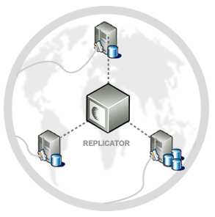
Types of Fragmentation:
Horizontal fragmentation: The union of the horizontal fragments must be equal to the original relation. Fragments are usually also required to be disjoint.
Vertical fragmentation: The collection of vertical fragments should be a lossless-join decomposition.
<number>
N.R.Sonawane
<number>

Slide 66
<number>
N.R.Sonawane
<number>

Slide 67
Replication
Replication means that we store several copies of a relation or relation fragment.
The motivation for replication is twofold:
Increased availability of data:
Faster query evaluation:
Two kinds of replications
synchronous replication
asynchronous replication
<number>
N.R.Sonawane
<number>

Slide 68
DDBMS
Introduction to DDBMS
Architecture of DDBs
Storing data in DDBs
Distributed Catalog Management
Distributed Query Processing
Transaction Processing
Distributed concurrency control and recovery
<number>
N.R.Sonawane
1. Parallel DB /D.S.Jagli
<number>

Slide 69
4.Distributed Catalog Management
Naming Objects
If a relation is fragmented and replicated, we must be able to uniquely identify each replica of each fragment.
A local name field
A birth site field
Catalog Structure
A centralized system catalog can be used It is vulnerable to failure of the site containing the catalog).
An alternative is to maintain a copy of a global system catalog. compromises site autonomy,)
<number>
N.R.Sonawane
<number>

Slide 70
4.Distributed Catalog Management
A better approach:
Each site maintains a local catalog that describes all copies of data stored at that site.
In addition, the catalog at the birth site for a relation is responsible for keeping track of where replicas of the relation are stored.
<number>
N.R.Sonawane
<number>

Slide 71
DDBMS
Introduction to DDBMS
Architecture of DDBs
Storing data in DDBs
Distributed Catalog management
Distributed Query Processing
Transaction Processing
Distributed concurrency control and recovery
<number>
N.R.Sonawane
<number>

Slide 72
5.Distributed Query Processing
Distributed query processing: Transform a high-level query (of relational calculus/SQL) on a distributed database (i.e., a set of global relations) into an equivalent and efficient lower-level query (of relational algebra) on relation fragments.
Distributed query processing is more complex
– Fragmentation/replication of relations
– Additional communication costs
– Parallel execution
<number>
N.R.Sonawane
<number>

Slide 73
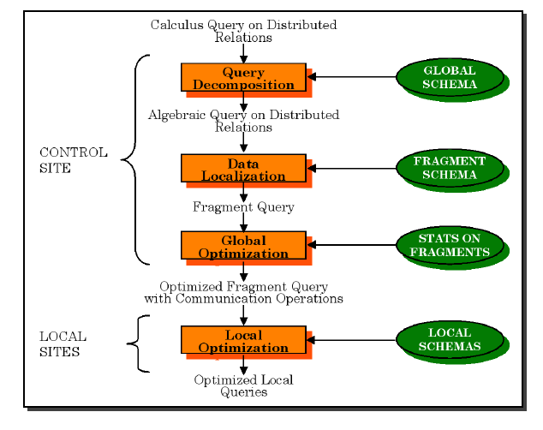
Distributed Query Processing Steps
<number>
N.R.Sonawane

Slide 74
6.DISTRIBUTED TRANSACTIONS PROCESSING
A given transaction is submitted at some one site, but it can access data at other sites.
When a transaction is submitted at some site, the transaction manager at that site breaks it up into a collection of one or more subtransactions that execute at different sites.
<number>
N.R.Sonawane

Slide 75
7.Distributed Concurrency Control
Lock management can be distributed across sites in many ways:
Centralized: A single site is incharge of handling lock and unlock requests for all objects.
Primary copy: One copy of each object is designated as the primary copy.
All requests to lock or unlock a copy of this object are handled by the lock manager at the site where the primary copy is stored.
Fully distributed: Requests to lock or unlock a copy of an object stored at a site are handled by the lock manager at the site where the copy is stored.
<number>
N.R.Sonawane
<number>

Slide 76
7.Distributed Concurrency Control
Distributed Deadlock Detection:
Each site maintains a local waits-for graph.
A global deadlock might exist even if the local graphs contain no cycles:
Three solutions:
Centralized: send all local graphs to one site ;
Hierarchical: organize sites into a hierarchy and send local graphs to parent in the hierarchy;
Timeout : abort Xact if it waits too long.
<number>
N.R.Sonawane

Slide 77
Phantom Deadlocks: delays in propagating local information might cause the deadlock detection algorithm to identify `deadlocks' that do not really exist. Such situations are called phantom deadlocks
<number>
N.R.Sonawane

Slide 78
7.Distributed Recovery
Recovery in a distributed DBMS is more complicated than in a centralized DBMS for the following reasons:
New kinds of failure can arise:
failure of communication links.
failure of a remote site at which a subtransaction is executing.
Either all subtransactions of a given transaction must commit, or none must commit.
This property must be guaranteed in spite of any combination of site and link failures.
<number>
N.R.Sonawane

Slide 79
7.Distributed Recovery
Two-Phase Commit (2PC):
Site at which Xact originates is coordinator;
other sites at which it executes subXact are subordinates.
When the user decides to commit a transaction:
The commit command is sent to the coordinator for the transaction.
This initiates the 2PC protocol:
<number>
N.R.Sonawane

Slide 80
7.Distributed Recovery(2pc)
Coordinator sends prepare msg to each subordinate.
Subordinate force-writes an abort or prepare log record and then sends a no or yes msg to coordinator.
If coordinator gets all yes votes, force-writes a commit log record and sends commit msg to all subs. Else, force-writes abort log rec, and sends abort msg.
Subordinates force-write abort/commit log rec based on msg they get, then send ack msg to coordinator.
Coordinator writes end log rec after getting ack msg from all subs
<number>
N.R.Sonawane

Slide 81
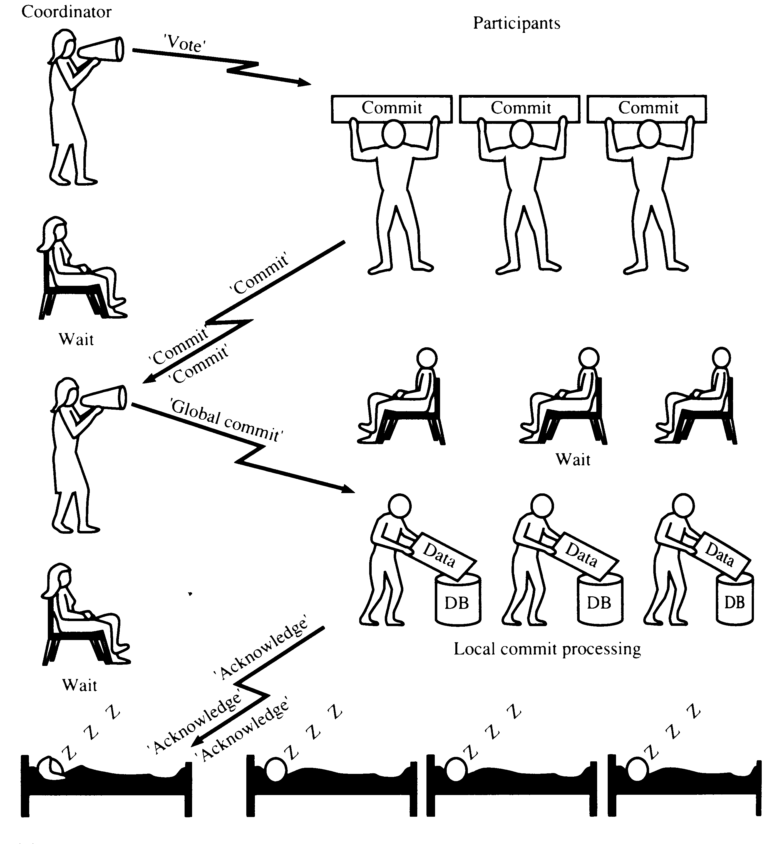
TWO-PHASE COMMIT (2PC) - commit
<number>
N.R.Sonawane

Slide 82
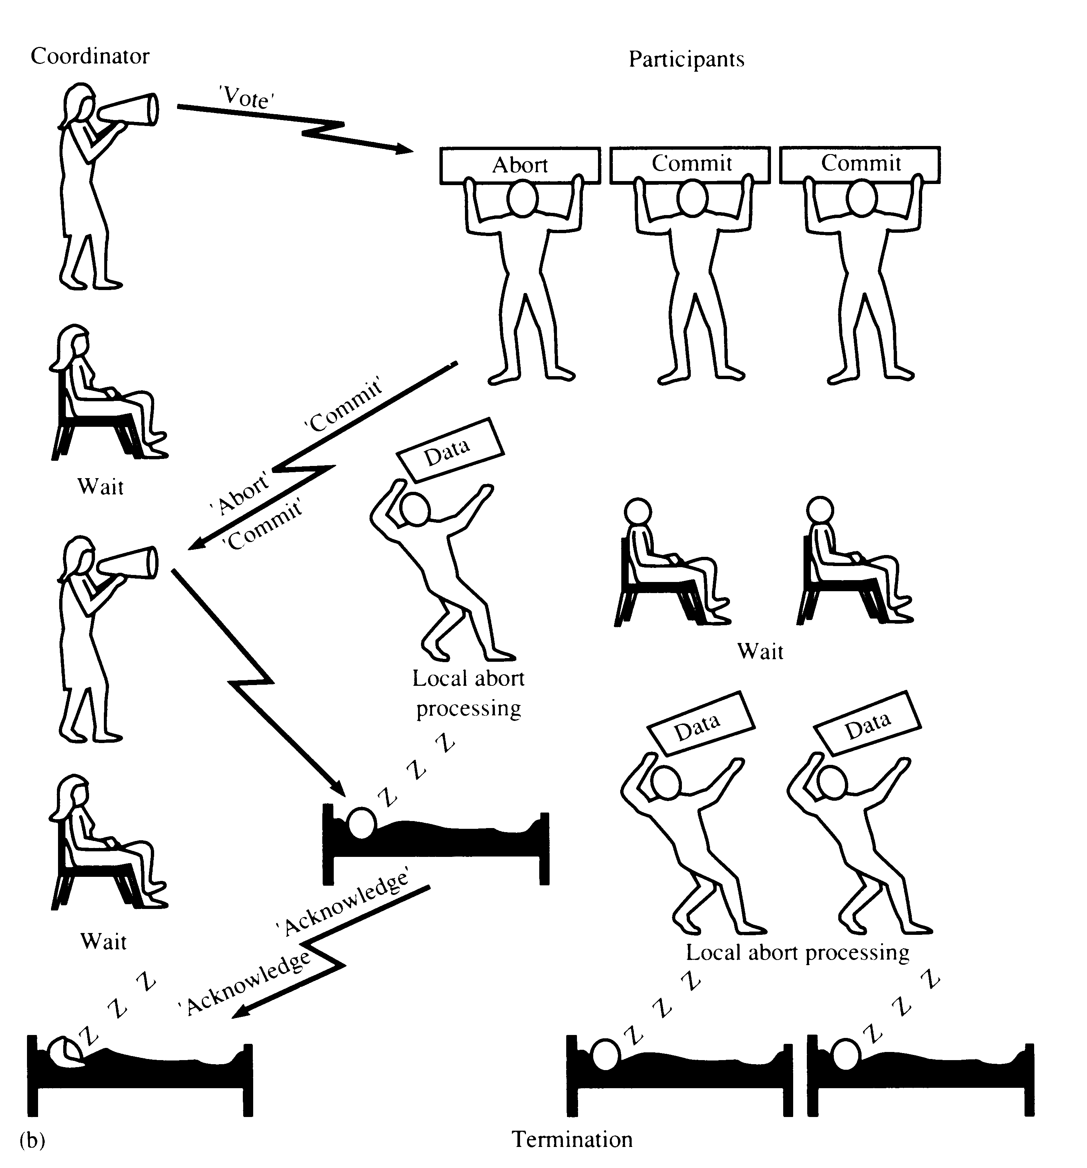
TWO-PHASE COMMIT (2PC) - ABORT
‘Global Abort’
<number>
N.R.Sonawane

Slide 83
7.Distributed Recovery(3pc)
Three-Phase Commit
A commit protocol called Three-Phase Commit (3PC) can avoid blocking even if the coordinator site fails during recovery.
The basic idea is that when the coordinator sends out prepare messages and receives yes votes from all subordinates.
It sends all sites a precommit message, rather than a commit message.
When a sufficient number more than the maximum number of failures that must be handled of acks have been received.
The coordinator force-writes a commit log record and sends a commit message to all subordinates.
<number>
N.R.Sonawane

Slide 84
Distributed Database
Advantages:
Reliability
Performance
Growth (incremental)
Local control
Transparency
Disadvantages:
Complexity of Query opt.
Concurrency control
Recovery
Catalog management
<number>
N.R.Sonawane

Slide 85
Thank you Queries?
<number>
N.R.Sonawane

Slide 86
Parallel External Sort-Merge Technique
Assumptions:
Assume n processors, P₀, P₁, …, P_{n-1} and n disks D₀, D₁, …, D_{n-1}.
Disk D_{i} is associated with Processor P_{i}.
Relation R is partitioned into R₀, R₁, …, R_{n-1} using Round-robin technique or Hash Partitioning technique or Range Partitioning technique (partitioned on any attribute)
Objective:
Our objective is to sort a relation (table) R_{i} on an attribute A in parallel where R resides on n disks.
Steps:
Step 1: Sort the relation partition R_{i} which is stored on disk D_{i} on the sorting attribute of the query.
Step 2: Identify a range partition vector v and range partition every R_{i} into processors, P₀, P₁, …, P_{n-1} using vector v.
Step 3: Each processor P_{i} performs a merge on the incoming range partitioned data from every other processors (The data are actually transferred in order. That is, all processors send first partition into P0, then all processors sends second partition into P1, and so on).
Step 4: Finally, concatenate all the sorted data from different processors to get the final result.
<number>
N.R.Sonawane

Slide 87
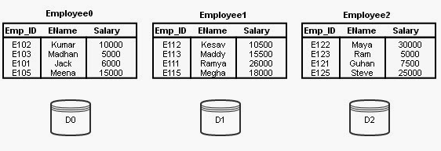
Consider the following relation schema Employee;
Employee (Emp_ID, EName, Salary)
Assume that relation Employee is permanently partitioned using Round-robin technique into 3 disks D₀, D₁, and D₂ which are associated with processors P₀, P₁, and P₂.
Assume that the following sorting query is initiated.
SELECT * FROM Employee ORDER BY Salary;
the table Employee is not partitioned on the sorting attribute Salary. Then, the Parallel External Sort-Merge technique works as follows
<number>
N.R.Sonawane

Slide 88
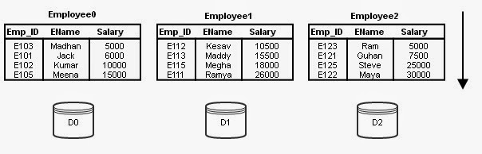
Step 1:
Sort the data stored in every partition (every disk) using the ordering attribute Salary. (Sorting of data in every partition is done temporarily). At this stage every Employee_{i} contains salary values of range minimum to maximum. The partitions sorted in ascending order is shown below, in Figure 2.
<number>
N.R.Sonawane

Slide 89
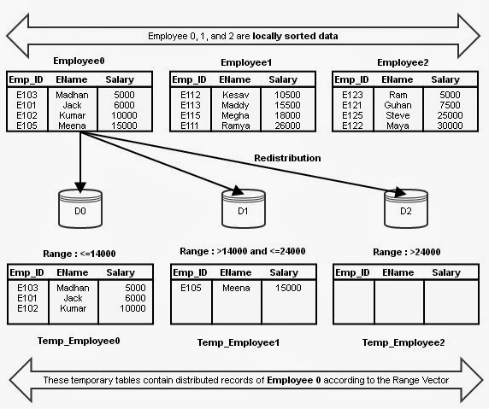
Step 2:
For our example, let us assume the following range vector;
v[14000, 24000]
This range vector represents 3 ranges, range 0 (14000 and less), range 1 (14001 to 24000) and range 2 (24001 and more).
Redistribute every partition (Employee0, Employee1 and Employee2) using these range vectors into 3 disks temporarily.
<number>
N.R.Sonawane

Slide 90
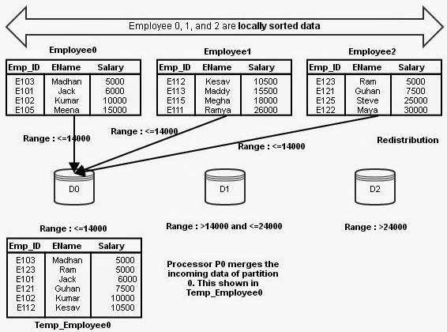
Step 3:
Actually, the above said distribution is executed at all processors in parallel such that processors P0, P1, and P2 are sending the first partition of Employee 0, 1, and 2 to disk 0. Upon receiving the records from various partitions, the receiving processor P0 merges the sorted data.
<number>
N.R.Sonawane

Slide 91
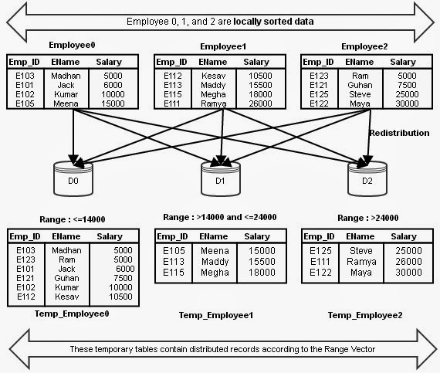
The above said process is done at all processors for different partitions. The final version of Temp_Employee 0, 1, and 2 are shown in Figure
<number>
N.R.Sonawane

Slide 92
Parallel Join Technique - Partitioned Join
The relational tables that are to be joined gets partitioned on the joining attributes of both tables using same partitioning function to perform Join operation in parallel.
Assume that relational tables r and s need to be joined using attributes r.A and s.B. The system partitions both r and s using same partitioning technique into n partitions. In this process A and B attributes (joining attributes) to be used as partitioning attributes as well for r and s respectively. r is partitioned into r₀, r₁, r₂, …, r_{n-1} and s is partitioned into s₀, s₁, s₂, …, s_{n-1}. Then, the system sends partitions r_{i} and s_{i} into processor P_{i}, where the join is performed locally.
<number>
N.R.Sonawane

Slide 93
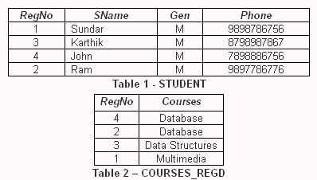
Let us assume the following;
The RegNo attributes of tables STUDENT and COURSES_REGD are used for joining.
Observe the order of tuples in both tables. They are not in particular order. They are stored in random order on RegNo.
<number>
N.R.Sonawane

Slide 94
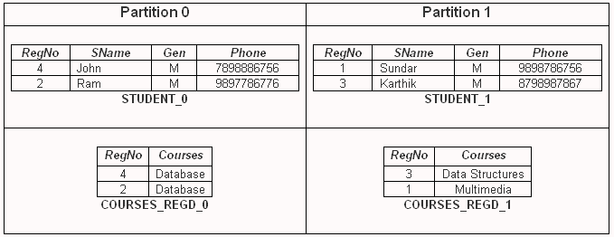
Partition the tables on RegNo attribute using Hash Partition. We have 2 disks and we need to partition the relational tables into two partitions (possibly equal). Hence, n is 2.
The hash function is, h(RegNo) = (RegNo mod n) = (RegNo mod 2). And, if we apply the hash function we shall get the tables STUDENT and COURSES_REGD partitioned into Disk₀ and Disk₁ as stated below.
From the above table, it is very clear that the same RegNo values of both tables STUDENT and COURSES_REGD are sent to same partitions. Now, join can be performed locally at every processor in parallel.
<number>
N.R.Sonawane

Slide 95
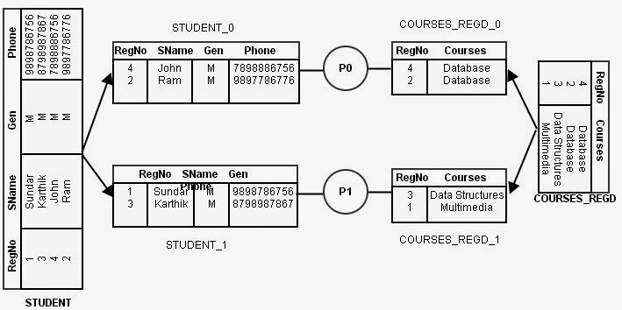
<number>
N.R.Sonawane

Slide 96
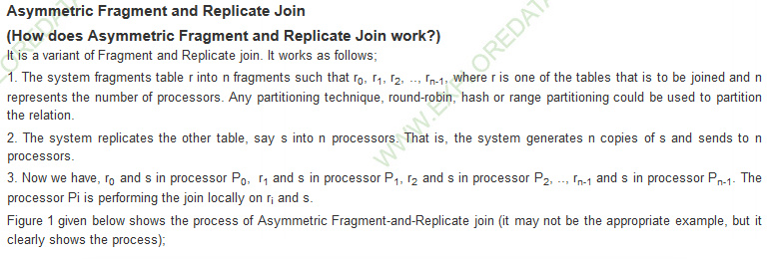
<number>
N.R.Sonawane

Slide 97
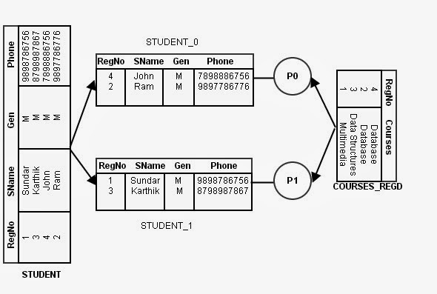
Fragment and Replicate Join
<number>
N.R.Sonawane

Slide 98
Points to note:
1. There are only two ways of partitioning the relations,
Range partitioning on the join attributes or
Hash partitioning on the join attributes.
2. Only equi-joins and natural joins can be performed in parallel using Partitioned Join technique.
3. Non-equi-joins cannot be performed with this method
.
4. After successful partitioning, the records at every processor can be joined locally using any of the joining techniques hash join, merge join, or nested loop join
.
5. If Range partitioning technique is used to partition the relations into n processors, Skew may present a special problem. That is, for some partitions, we may get fewer records (tuples) for one relation for a given range and many records for other relation for the same range.
6. With Hash partitioning, if there are many tuples with same value in one relation then the difference both relations is possible in one partition. Otherwise, skew has minimal effect.
7. The number of comparisons between relations are well reduced in partitioned join parallel technique.
<number>
N.R.Sonawane

